Slide 1
The Hands of Fate
Geopolitics and International Finance in an Age of Globalization
Brett I. Kier

Slide 2
Geopolitics and International Finance in an Age of Globalization
“Globalization is not a monolithic force but an evolving set of consequences - some good, some
bad and some unintended. It is the new reality.”
~John B. Larson
U.S. Congressman

Slide 3
YOU ARE HERE

Slide 4
Agenda
International Finance
Alchemy of Money Creation
Bretton Woods Conference (1944)
Triffin Paradox
The Big Picture
The Grand Chessboard
Bancor Redux
Agenda 21
Setting the Table
Power and Ideology
Geopolitics
The Geographical Pivot of History (1904)
WOD, WOT, and SCAD

Slide 5
Axis of Power and Ideology
Tyranny
Centralization
POWER
Them
Us
HORIZONTAL AXIS
IDEOLOGY
VERTICAL AXIS
Good
Evil
Decentralization
Freedom

Slide 6
IDEOLOGY: WHO STARTS WARS?
*Note: When military engagements begin during one administration and carry over into another, they are counted once for each administration.
Sources: https://en.wikipedia.org/wiki/Timeline_of_United_States_military_operations; https://en.wikipedia.org/wiki/List_of_Presidents_of_the_United_States

Slide 7
POWER: WHO SUPPORTS WARS?
Source: http://www.lowvarates.com/va-loan-blog/military-spending-republicans-vs-democrats/

Slide 8
Political and Economic Power
CREATE AND CONTROL SCARCITY
Political Power is the ability to control scarcity (resources that are in limited supply – manufactured or actual).
Economic Power is the ability to create scarcity.
Economic Power is used for the purpose of expanding or strengthening Political Power.

Slide 9
Geopolitics
“History is laden with belligerent leaders using humanitarian rhetoric to mask geopolitical aims. History also shows how often ill-informed moralism has led to foreign entanglements that do more harm than good.”
~Samantha Power
U.S. Ambassador to the United Nations

Slide 10
The Geographical Pivot of History: The Heartland Theory
Location, Location, Location!

Slide 11
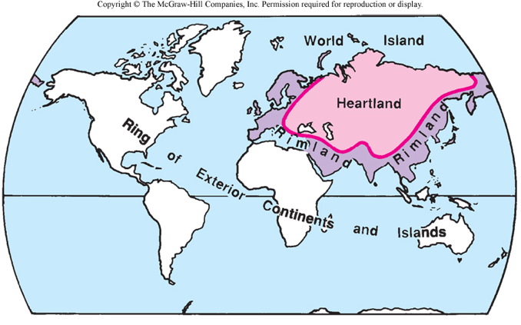
The Heartland Theory: The Great Game

Slide 12
More Players, Same Game
The Great Game
Britain vs. Russia
(ca. 1813-1907)
The Great Game II
Unites States vs. Soviet Union
Cold War (ca. 1947 – 1991)
The New Great Game
The West vs. The Rest
Post Cold War – The Present

Slide 13
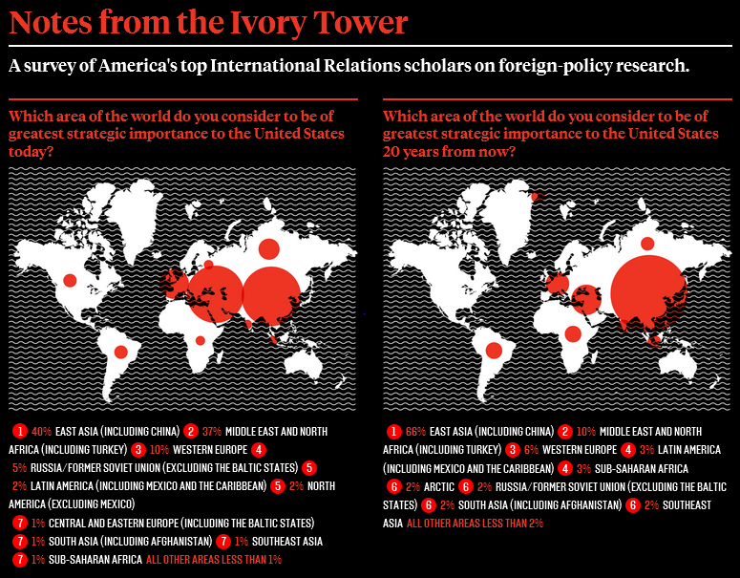

Slide 14
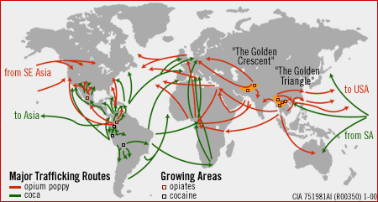
The War on Drugs

Slide 15
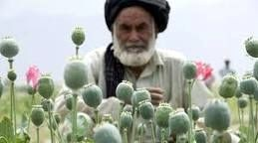
Heroin: Al Qaeda’s Cash Crop

Slide 16
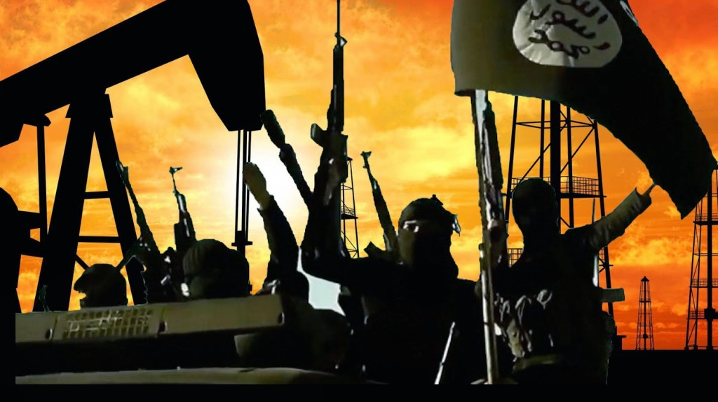
Oil: The ISIS (Sunni Wahhabist) Advantage

Slide 17
The War on Terrorism
“If Western intervention in Afghanistan created the Mujahideen, Western intervention in Bosnia appears to have globalized it.”
~Nafeez Mosaddeq Ahmed
Institute for Policy Research and Development

Slide 18
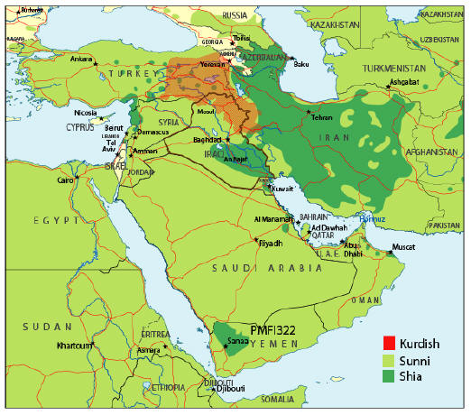
Geo-Politics: Major Factions

Slide 19
The War on Terrorism: Blowback?

Slide 20
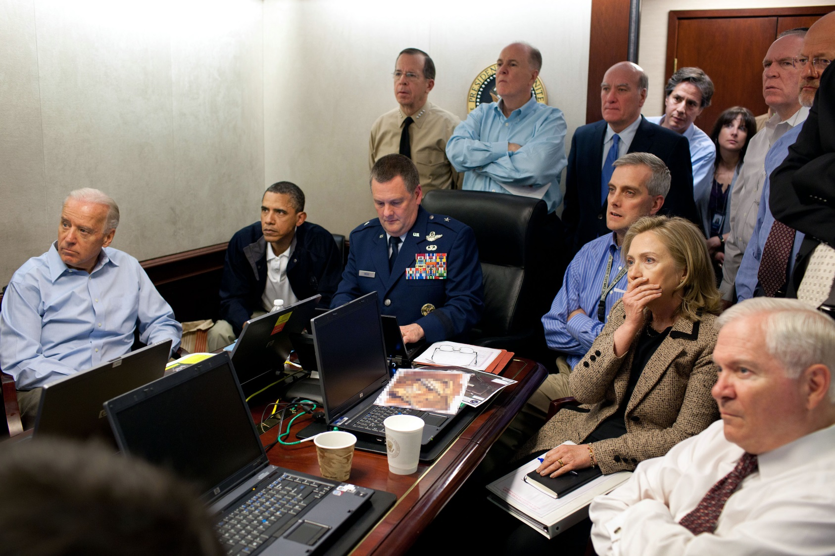
ISIS: Rebranding Al Qaeda

Slide 21
State Crimes Against Democracy
SCAD committed in service of domestic and international interests engaged in the New Great Game
JFK Assassination (1963)
JFK Jr. Assassination (1999)
MLK Assassination (1968)
RFK Assassination (1968)
Reagan Assassination Attempt (1981)
World Trade Center Bombings (1993, 2001)
Oklahoma City Bombing (1995)
Pentagon Bombing (2001)
Anthrax Attacks (2001)
London Bombings (2005)
Newtown Shooting (2012)
Boston Marathon Bombing Operation (2013)
Paris Shootings (2013, 2015)
San Bernardino Shooting (2015)

Slide 22
International Finance
“All the perplexities, confusion and distress in America arise, not from defects in their Constitution or Confederation, not from want of honor or virtue, so much as from the downright ignorance of the nature of coin, credit and circulation.”
~John Adams
2nd President of the United States

Slide 23
The Alchemy of Money Creation
“He who controls the money supply of a nation controls the nation.”
~James A. Garfield
20th President of the United States

Slide 24
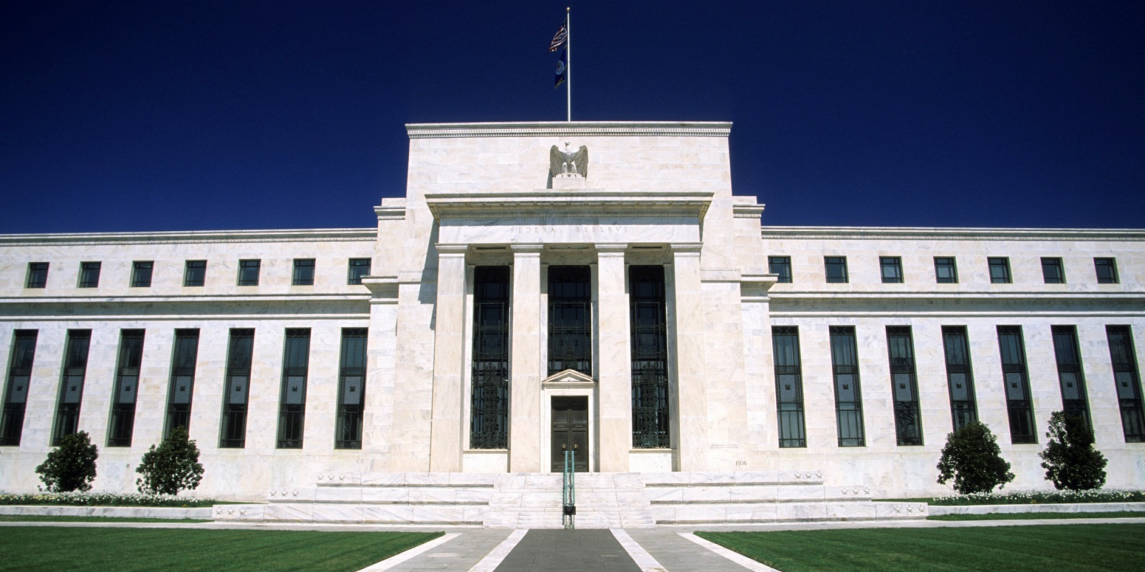
Corporate & Private Fiat Currency
Since 1913
Not Federal
Has No Reserves
Private Bank

Slide 25
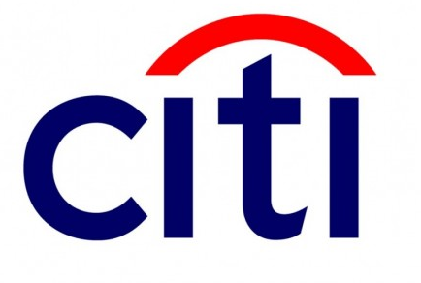
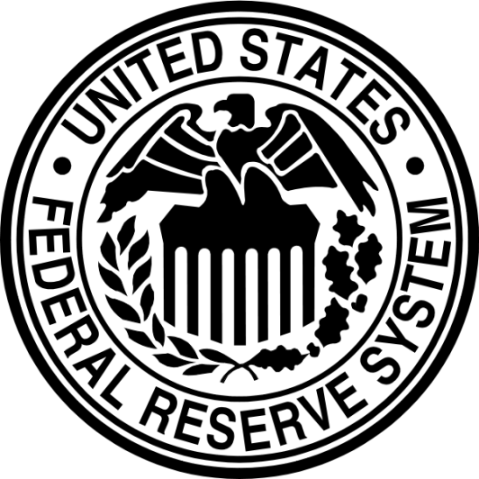
Fractional Reserve Lending
$1 = -$10

Slide 26
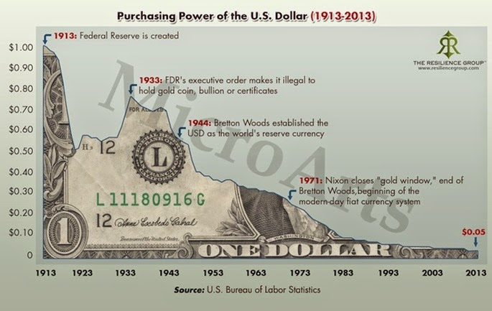
Debt-based Monetary System

Slide 27
Bretton Woods Conference 1944
Post WWII Spoils of War Conference
IMF creation
US Dollar Global Reserve currency
Bancor proposal was abandoned in favor of US Dollar

Slide 28
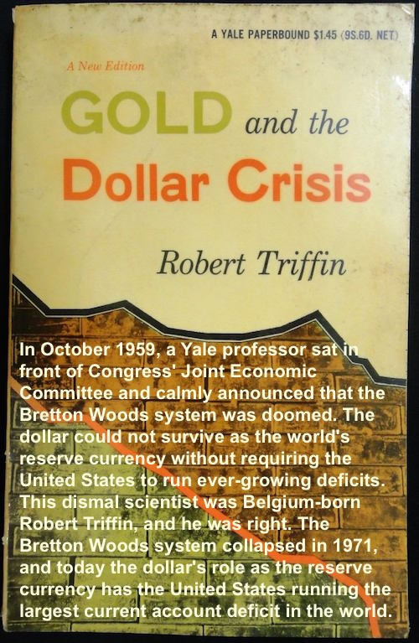
Triffin Paradox
“In the wake of the financial crisis of 2007–2008, the governor of the People's Bank of China explicitly named the Triffin Dilemma as the root cause of the economic disorder, in a speech titled Reform the International Monetary System (my italics). Zhou Xiaochuan's speech of 29 March 2009 proposed strengthening existing global currency controls, through the IMF.”
Source: https://en.wikipedia.org/wiki/Triffin_dilemma

Slide 29
Bancor Redux: Special Drawing Rights

Slide 30
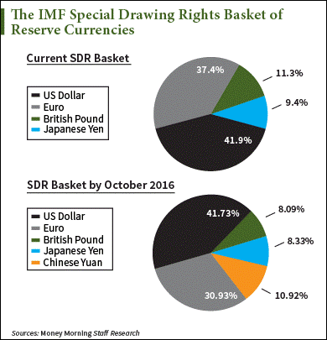
SDRs: The New Global Reserve Currency

Slide 31
The Big Picture

Slide 32
The Grand Chessboard

Slide 33
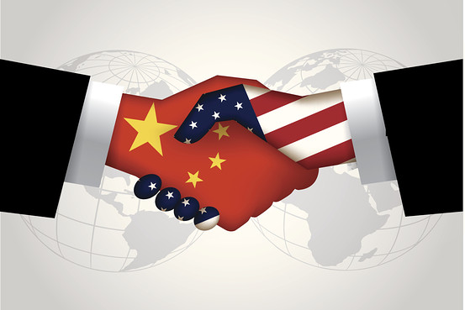
US-China Relations

Slide 34
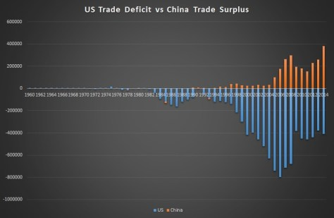
US-China Relations

Slide 35
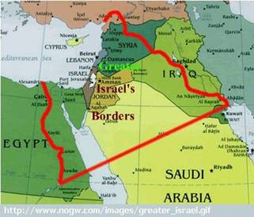
Israel: Oded Yinon Plan
Divide et Impera

Slide 36
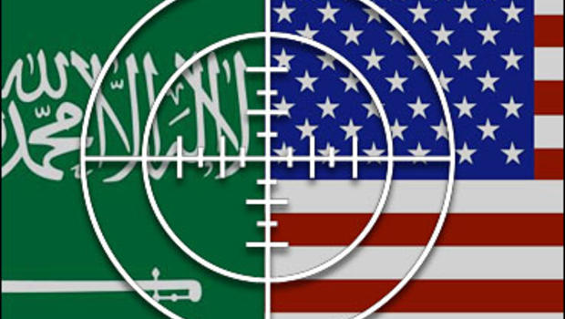
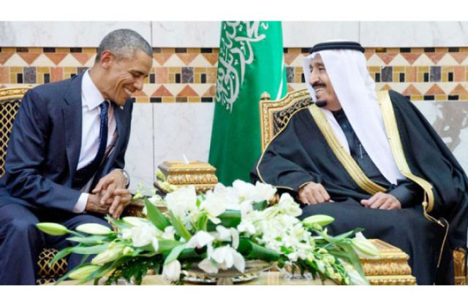
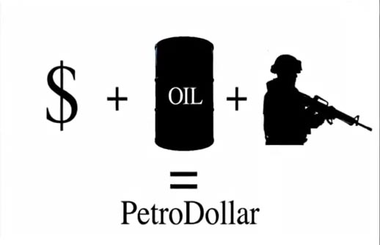
US-Saudi Relations

Slide 37
Agenda 21 (Agenda 2030)
The United Nations plan for sustainable development to combat overpopulation, biodiversity and “climate change.”

Slide 38
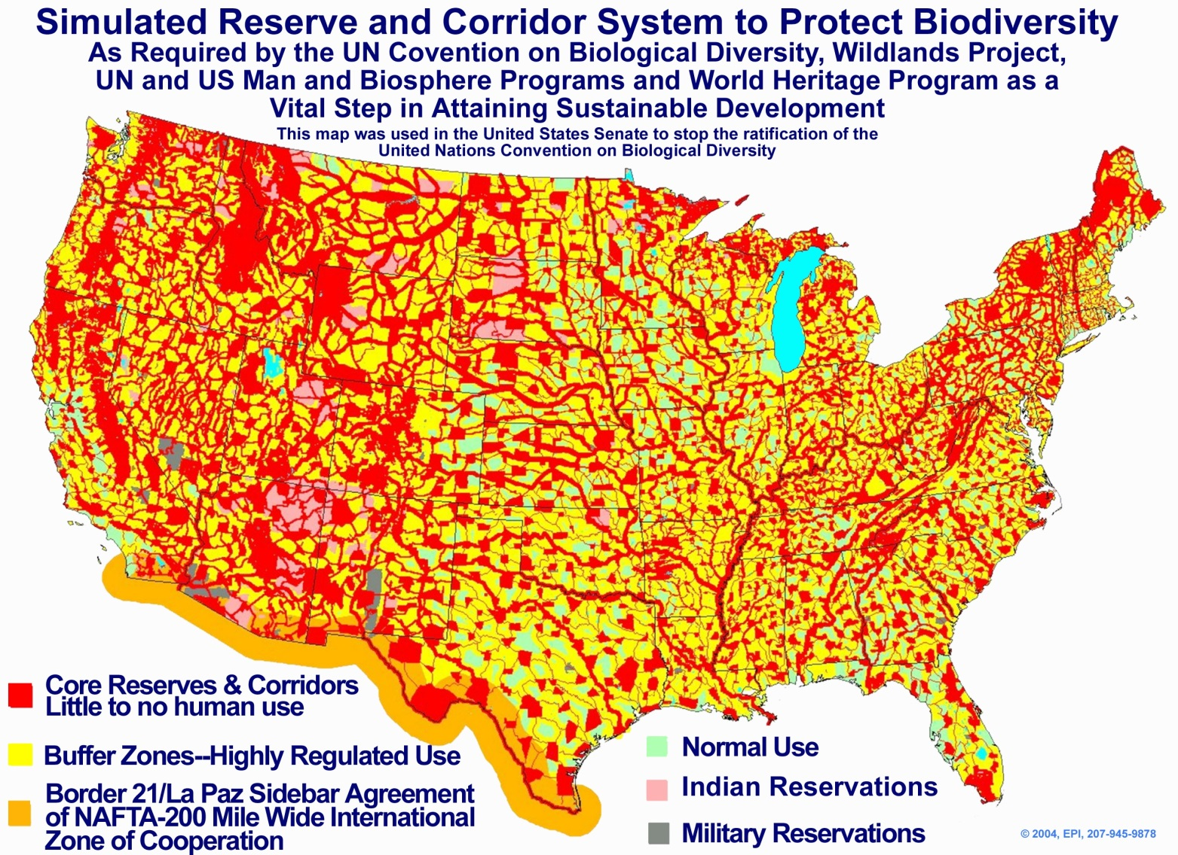
Agenda 21 (Agenda 2030)

Slide 39
Black Budgets: How Do They Pay For All This Stuff?
US Federal Budget
2016 – $4.0 trillion
2015 – $3.9 trillion
2014 – $3.5 trillion
2013 – $3.8 trillion
2012 – $3.7 trillion
2011 – $3.8 trillion
2010 – $3.6 trillion
US Federal Budget
2009 – $3.5 trillion
2008 – $2.9 trillion
2007 – $2.8 trillion
2006 – $2.7 trillion
2005 – $2.4 trillion
2004 – $2.3 trillion
2003 – $2.2 trillion
US Federal Budget
2002 – $2.0 trillion
2001 – $1.9 trillion
2000 – $1.8 trillion
1999 – $1.7 trillion
1998 – $1.7 trillion
1997 – $1.6 trillion
US Pentagon: Unaccounted for Expenditures Since 1996
$8.5 Trillion Dollars*
*(Sep. 10, 2001: Donald Rumsfeld reported $2.3 Trillion missing in 2000; with private financial entities hiding between 21-32 Trillion Dollars offshore, according to the recently released Panama Papers)

Slide 40
The Hands of Fate
Geopolitics and International Finance in an Age of Globalization
Brett I. Kier

