Slide 1
The Cold War Game
How did the West establish its dominance in the Cold War from the very beginning?

Slide 2
WWII: The Fight For Germany
USA
USSR
Atlanticists
Eurasianists
WEST
GERMANY
EAST
Sea Power
Land Power

Slide 3
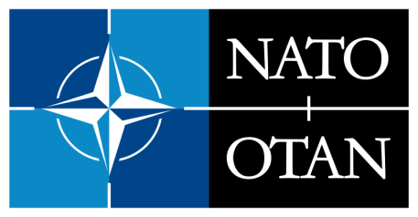
North Atlantic Treaty Organization
Military alliance – members agree to mutual defense in response to an attack by any external party (Article 5) "to keep the Russians out, the Americans in, and the Germans down"
NATO Stay Behind Armies-prevent an attempted Soviet takeover of Europe
Operation Gladio
Secret armies committed acts of terrorism and blamed it on the Soviets (communists)
Goal was to create a “strategy of tension”
“In silence, we serve freedom.”

Slide 4
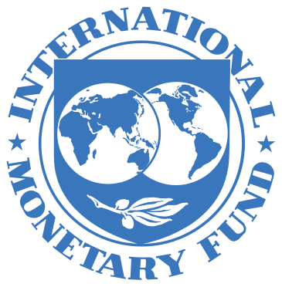
Bretton Woods Conference 1944
Allied nations decided the new financial rules of the world
International Monetary Fund & World Bank (1945)
Promote international monetary cooperation, trade, high employment, economic growth
Prevent poverty, and provide loans to countries in financial difficulty

Slide 5
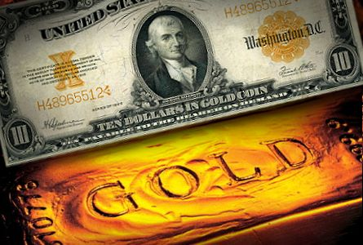
Bretton Woods Conference 1944
Promote international monetary cooperation
US Dollar-Gold Exchange
World Reserve Currency
Lender of last resort
All transactions would be completed using US Dollars

Slide 6
How did the Western world establish its PESC dominance at the close of WWII?
Using your Star Chart answer the following:
How did the West establish political dominance?
How did the West establish economic dominance?
How did the West establish social dominance?
How did the West establish cultural dominance

